Slide 1
FREEBIES FOR NEWBIES
A place to find free event and items
Client & Mentor:
Dr. Chandra Mouli Kotteti
Team Members:
Manoj Kumar Gude
Harish Chowdary Bala
Saibabu Devarapalli
Jaichand Mulakalapalli
Aditya Krishna Raavi
05

Slide 2
Team Members
JAICHAND MULAKALAPALLI
(TEAM LEADER) BACKEND
MANOJ KUMAR GUDE
FRONTEND
ADITHYA KRISHNA RAAVI
FRONTEND
Saibabu devarapalli
Fullstack
HARISH CHOWDARY BALA
DATABASE
DR. CHANDRA MOULI KOTTETI
Mentor & Client

Slide 3
Table of Contents
Introduction
References
Admin Home Activity
New Event Approval Activity
Update Event Approval Activity
Delete Event Approval Activity
Alert Dialog Builder
Alert Dialog Builder (Code)
Summary
Database Queries
<include> Tag
Lessons Learned

Slide 4




Introduction
Freebies for Newbies is an android application, which helps international students to access to free items and events in the desired location.
Tools and Design:
Android Studio - The tool used for the UI development.
GenyMotion - Emulator (Virtual device).
Git Hub - To integrate UI part and store it.
Oracle VirtualBox - Its an essential tool required to run for GenyMotion.
Back4App - Database.
Programming Language:
Java.

Slide 5
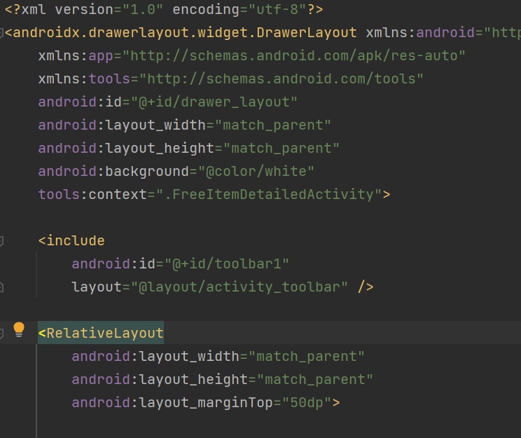
<include> Tag
Include is an efficient reusable feature by means of the <include>
In the main layout we can reuse the custom layout by using include tag.
The main advantage of including is you can use custom layout contents whenever necessary.
In our application in every layout, we assign a menu bar.
By creating a separate layout for the toolbar, we can reuse it as many times in the main activity.
Fig. 1: Include Tag XML code

Slide 6
Database Queries
Querying a Back4App database is straightforward and can be done using various methods depending on the type of database you are using. Back4App supports multiple databases, including MongoDB, PostgreSQL, and GraphQL.
Here's a brief overview of querying a Back4App database:
MongoDB Querying
PostgreSQL Querying
GraphQL Querying
When querying a Back4App database, it's important to consider the performance impact of your queries, especially as your database grows.
Back4App provides tools to monitor and optimize query performance, such as indexing and query profiling.
Notes:
MongoDB Querying: If you are using MongoDB as your database, you can query the database using the MongoDB query language. You can use the Back4App console to create and run MongoDB queries, or you can use one of the supported MongoDB clients to connect to your database and query it directly.
PostgreSQL Querying: If you are using PostgreSQL as your database, you can query the database using SQL. You can use the Back4App console to create and run SQL queries, or you can use one of the supported PostgreSQL clients to connect to your database and query it directly.
GraphQL Querying: If you are using GraphQL as your database, you can query the database using the GraphQL query language. You can use the Back4App console to create and run GraphQL queries, or you can use one of the supported GraphQL clients to connect to your database and query it directly.
When querying a Back4App database, it's important to consider the performance impact of your queries, especially as your database grows. Back4App provides tools to monitor and optimize query performance, such as indexing and query profiling. It's also important to consider the security implications of your queries, and to ensure that your queries are properly authenticated and authorized.

Slide 7
Database Queries (Create)
public void createObject() {
ParseObject entity = new ParseObject("EventDeleteRequest");
entity.put("DeleteEventID", "A string");
entity.put("DeleteReason", "A string");
entity.put("isApproved", true);
entity.put("eventName", "A string");
entity.put("updateEventId", "A string");
// Saves the new object.
// Notice that the SaveCallback is totally optional!
entity.saveInBackground(e -> {
if (e==null){
//Save was done
} else{
//Something went wrong
Toast.makeText(this, e.getMessage(), Toast.LENGTH_SHORT).show();
}
});
}
Fig. 2: EventDeleteRequest Create Query

Slide 8
Database Queries (Read)
public void readObject() {
ParseQuery<ParseObject> query = ParseQuery.getQuery("EventDeleteRequest");
// The query will search for a ParseObject, given its objectId.
// When the query finishes running, it will invoke the GetCallback
// with either the object, or the exception thrown query.getInBackground("<PARSE_OBJECT_ID>", (object, e) -> {
if (e == null) {
//Object was successfully retrieved
} else {
// something went wrong
Toast.makeText(this, e.getMessage(), Toast.LENGTH_SHORT).show();
}
});
}
Fig. 3: EventDeleteRequest Read Query

Slide 9
Database Queries (Update)
public void updateObject() {
ParseQuery<ParseObject> query = ParseQuery.getQuery("EventDeleteRequest"); // Retrieve the object by id
query.getInBackground("<PARSE_OBJECT_ID>", (object, e) -> {
if (e == null) {
//Object was successfully retrieved
// Update the fields we want to
object.put("DeleteEventID", "A string");
object.put("DeleteReason", "A string");
object.put("isApproved", true);
object.put("eventName", "A string");
object.put("updateEventId", "A string");
//All other fields will remain the same object.saveInBackground();
} else {
// something went wrong
Toast.makeText(this, e.getMessage(), Toast.LENGTH_SHORT).show();
}
});
}
Fig. 4: EventDeleteRequest Update Query

Slide 10
Database Queries (Delete)
public void deleteObject() {
ParseQuery<ParseObject> query = ParseQuery.getQuery("EventDeleteRequest");
// Retrieve the object by id
query.getInBackground("<PARSE_OBJECT_ID>", (object, e) -> {
if (e == null) {
//Object was fetched
//Deletes the fetched ParseObject from the database
object.deleteInBackground(e2 -> {
if(e2==null){
Toast.makeText(this, "Delete Successful", Toast.LENGTH_SHORT).show();
}else{
//Something went wrong while deleting the Object \
Toast.makeText(this,"Error: "+e2.getMessage(), Toast.LENGTH_SHORT).show();
}
});
}else{
//Something went wrong
Toast.makeText(this, e.getMessage(), Toast.LENGTH_SHORT).show();
}
});
}
Fig. 5: EventDeleteRequest Delete Query

Slide 11
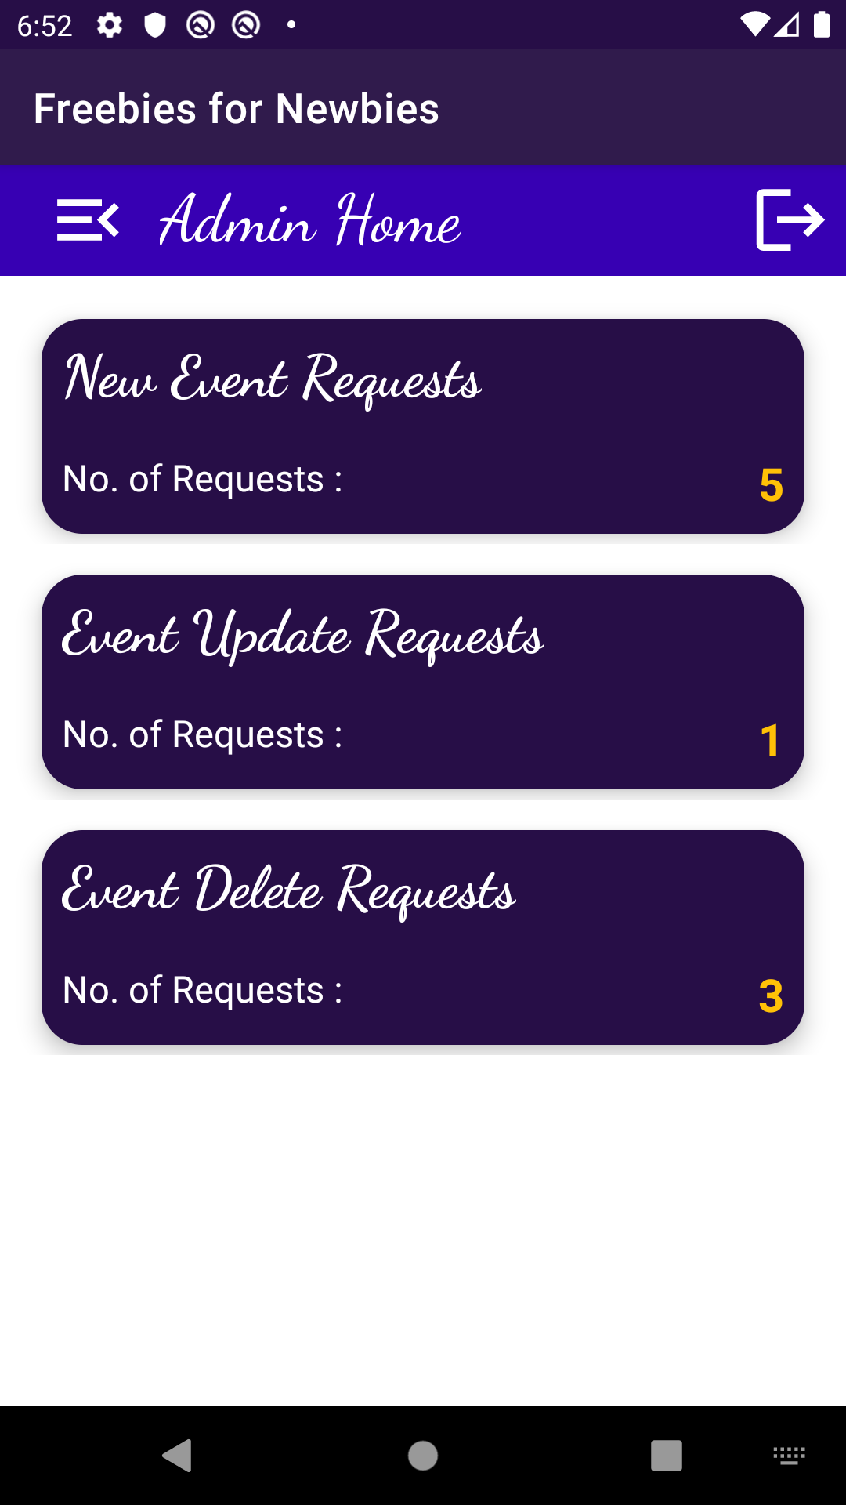
Admin Home Activity
Fig. 6 shows the Update Event Approval Activity
This activity contains a toolbar with menu options, title and logout option.
It has a recycler view which shows the list of events update requests that are to be reviewed.
When tapped on a particular event it will open a dialog box, which allows admin to approve or deny the request.
Once approved/Denied the event details will be updated accordingly in the database.
Fig. 6: Admin Home Activity

Slide 12
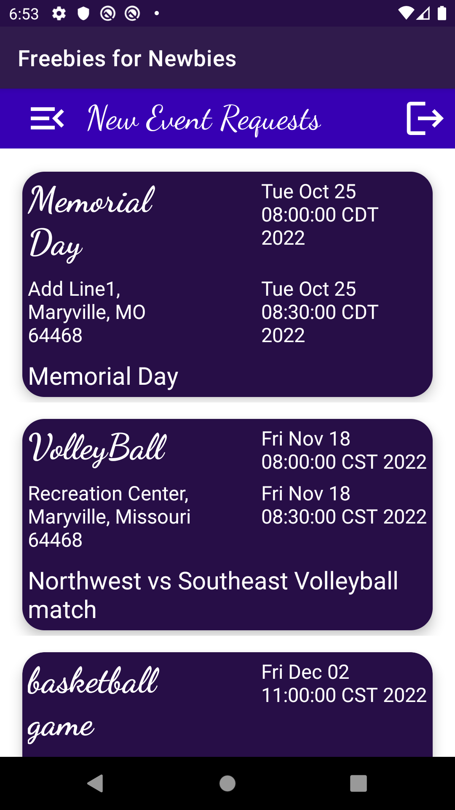
New Event Approval Activity
Fig. 7 shows the New Event Approval Activity
This activity contains a toolbar with menu options, title and logout option.
It has a recycler view which shows the list of events update requests that are to be reviewed.
When tapped on a particular event it will open a dialog box, which allows admin to approve or deny the request.
Once approved/Denied the event details will be updated accordingly in the database.
Fig. 7: New Event Approval Activity

Slide 13
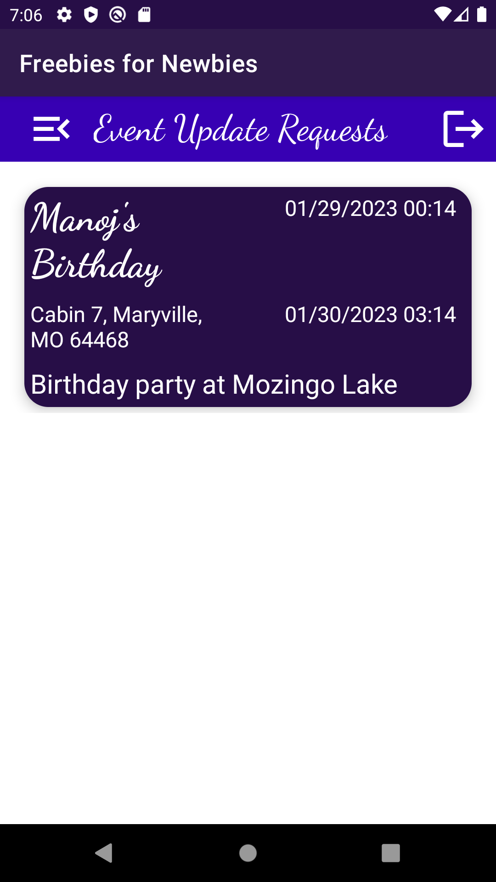
Update Event Approval Activity
Fig. 8 shows the Update Event Approval Activity
This activity contains a toolbar with menu options, title and logout option.
It has a recycler view which shows the list of events update requests that are to be reviewed.
When tapped on a particular event it will open a dialog box, which allows admin to approve or deny the request.
Once approved/Denied the event details will be updated accordingly in the database.
Fig. 8: Update Event Approval Activity

Slide 14
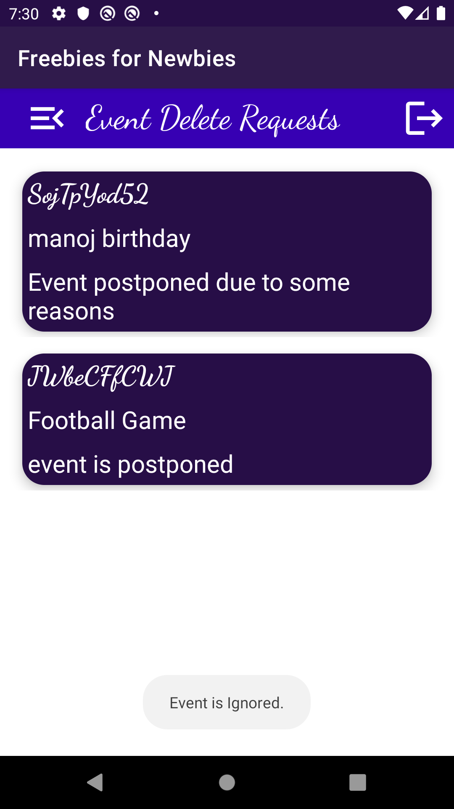
Delete Event Approval Activity
Fig. 9 shows the Delete Event Approval Activity
This activity contains a toolbar with menu options, title and logout option.
It has a recycler view which shows the list of events delete requests that are to be reviewed.
When tapped on a particular event it will open a dialog box, which allows admin to approve or deny the request.
Once approved/Denied the event details will be updated accordingly in the database.
Fig. 9: Delete Event Approval Activity

Slide 15
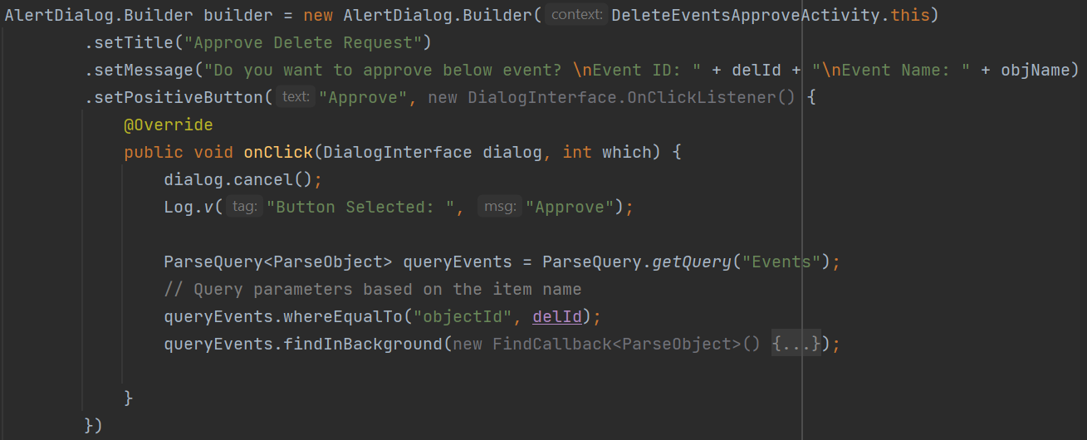
Alert Dialog Builder (Code)
Fig. 10: Dialog Builder code (part1)

Slide 16
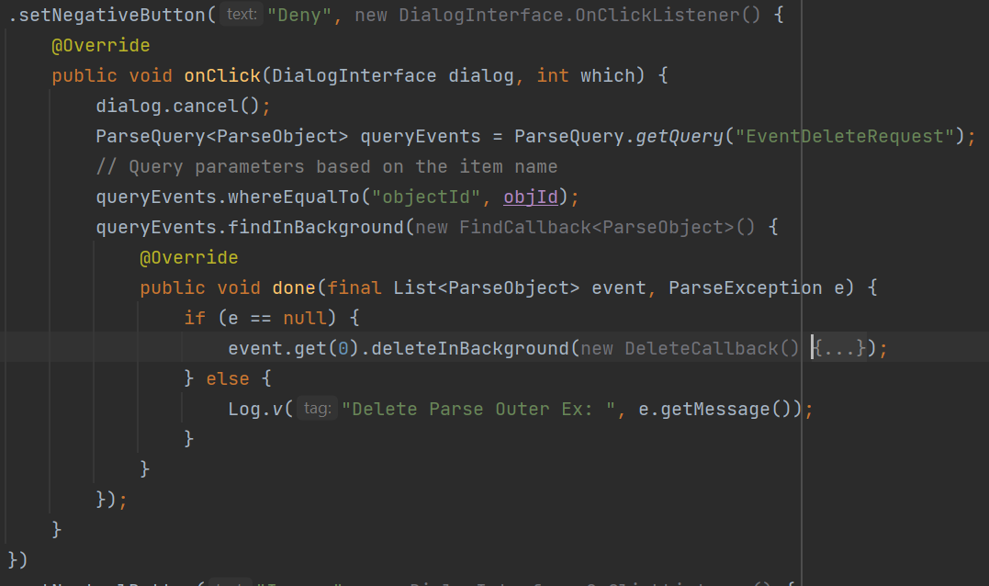
Alert Dialog Builder (Code)
Fig. 11: Dialog Builder code (part2)

Slide 17
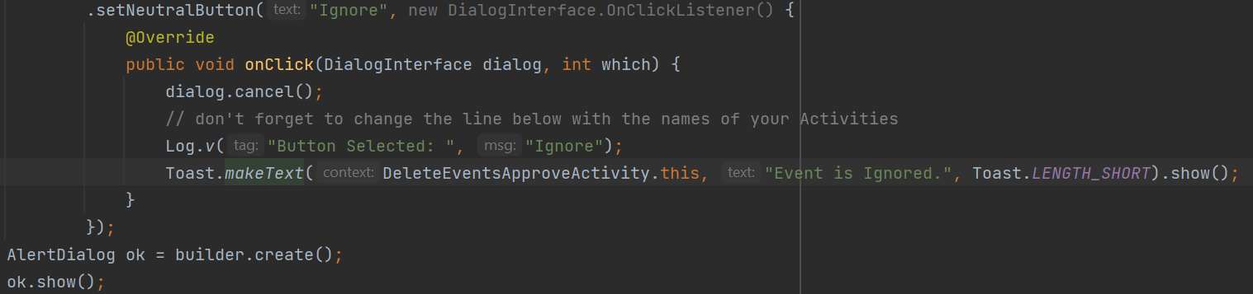
Alert Dialog Builder (Code)
Fig. 12: Dialog Builder code (part3)

Slide 18
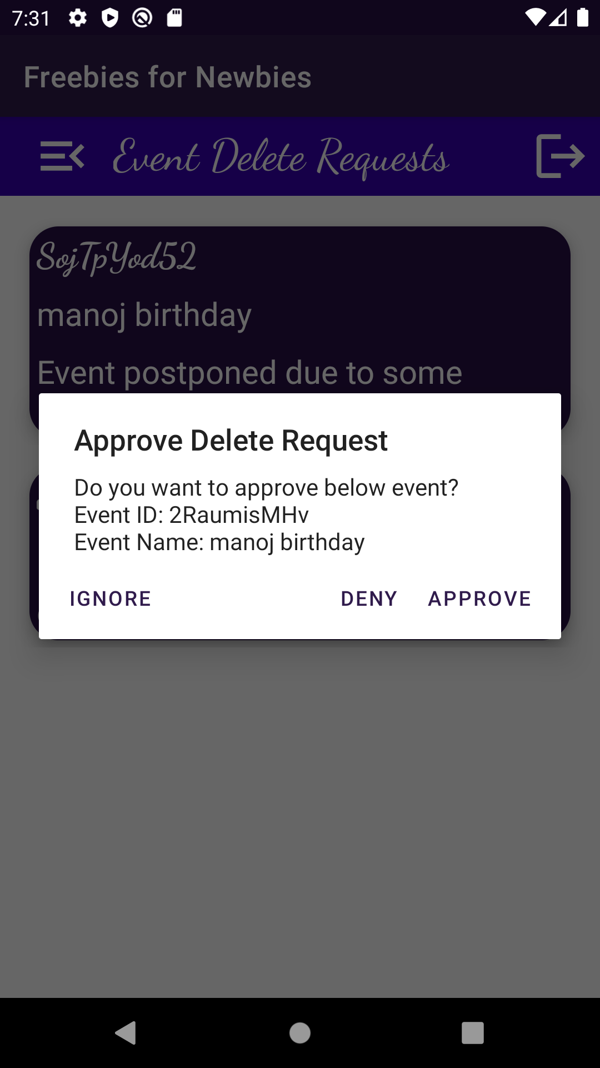
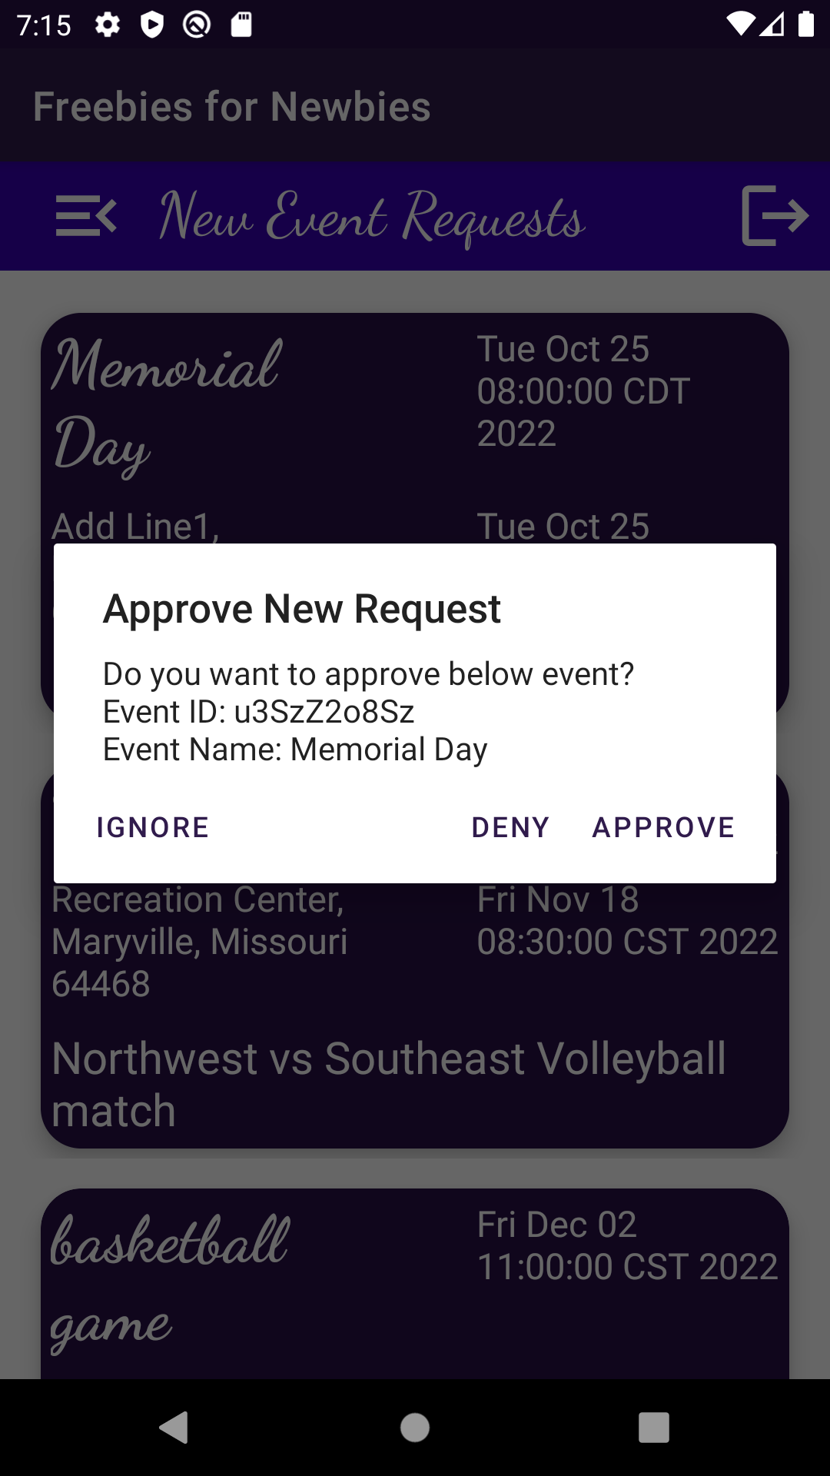
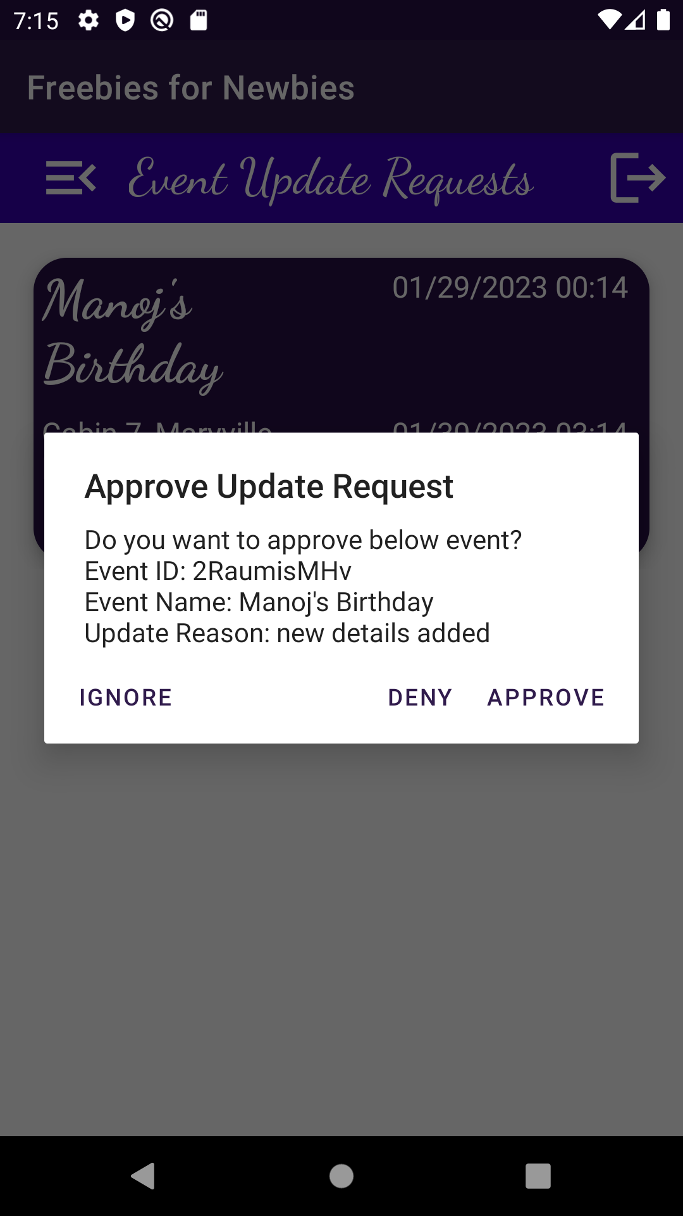
Alert Dialog Builder (Output)
Fig. 13.1: Delete Activity
Fig. 13.2: New Activity
Fig. 13.3: Update Activity

Slide 19
Lessons Learned
In the recent sprints, we have been working on implementing administrative functionalities to approve user requests and store the data in a single table.
However, this approach resulted in unnecessary data replication and an insufficient data model for tracking different types of requests (Example: new event requests, update event requests, delete event requests).
To resolve this issue, we have decided to create separate tables for each type of request.

Slide 20
Summary
Dialogs are crucial for developers to communicate, prompt, or display errors.
Android Dialogue Builder simplifies creation, customization and behavior management of dialogs.
Inefficient data storing techniques for handling user requests and tracking led to separate tables being created for each request type.

Slide 21
References
Image sources:
Back4App: https://www.back4app.com/
Android Studio: https://developer.android.com/studio
GenyMotion: https://www.genymotion.com/
VirtualBox: https://commons.wikimedia.org/wiki/File:Virtualbox_logo.png
Project links:
Github: https://github.com/Sec03Team05Fall22GDP1/FreebiesforNewbies

Slide 22

Any Questions?

Slide 23




Slide 24
Team Members
JAICHAND MULAKALAPALLI
(TEAM LEADER) BACKEND
MANOJ KUMAR GUDE
FRONTEND
ADITHYA KRISHNA RAAVI
FRONTEND
Saibabu devarapalli
Fullstack
HARISH CHOWDARY BALA
DATABASE
DR. CHANDRA MOULI KOTTETI
Mentor & Client

Slide 25
FREEBIES FOR NEWBIES
A place to find free event and items
Client & Mentor:
Dr. Chandra Mouli Kotteti
Team Members:
Manoj Kumar Gude
Harish Chowdary Bala
Saibabu Devarapalli
Jaichand Mulakalapalli
Aditya Krishna Raavi
05

